Slide 1
Question 4
Correlation between Covid vaccination compaign and deaths

Slide 2





Data collection 4 Data sources
3 CSV file
Deaths per day and per country
Vaccination End Of period
Source : World Heath Organisation :
https://data.who.int/dashboards/covid19/data?n=o
Vaccination per day and per country
Source : KAGGLE :
https://www.kaggle.com/datasets/fedesoriano/coronavirus-covid19-vaccinations-data?resource=download
1 API’s
Countries referential + Population per country
API World Bank :
https://api.worldbank.org/v2/country?format=json

Slide 3
Data cleaning and transformation
For the daily data : vaccination and deaths
Outliers were removed using IQR method
A moving average (7days) was used to smooth the data
Data for vaccination was not available for the full period, this data was removed
Data per region is directly originated from data per country
No significant transformation was applied on data per country

Slide 4
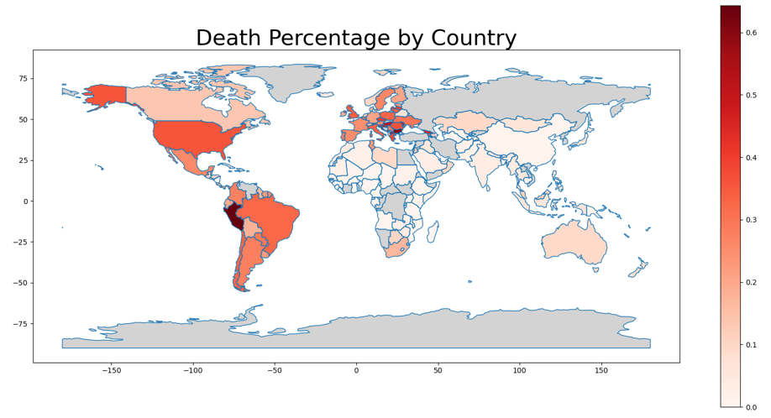
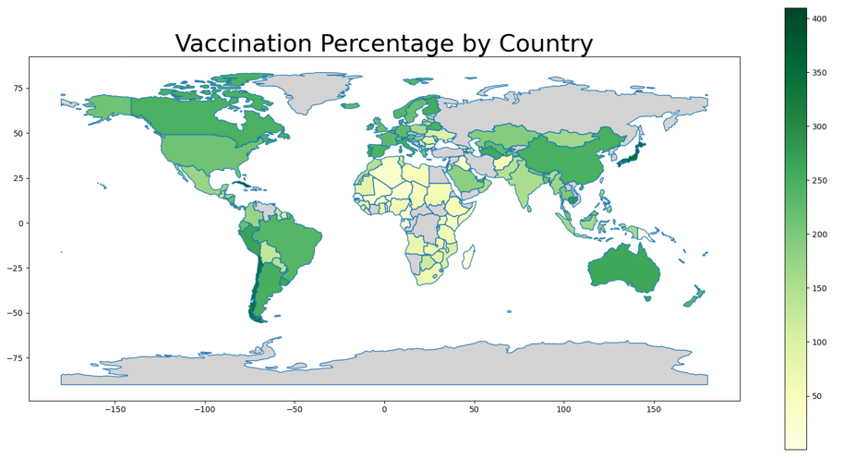
Analysis Is there a Correlation between Covid vaccination compaign and deaths?

Slide 5
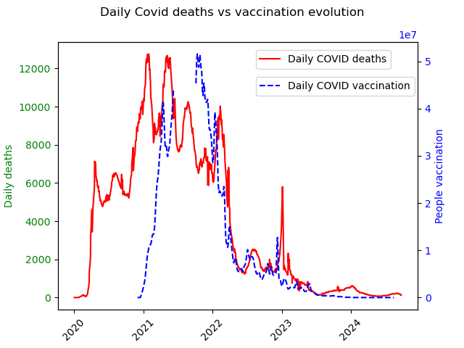
Analysis Is there a Correlation between Covid vaccination compaign and deaths?
This chart shows how the daily deceases due to COVID evolved between the beginning of the pandemic till today,
There was several pics corresponding to the different waves
Since the launch of the vaccines late 2020, the number od deaths starts decreasing which would suggest a correlation between the vaccination campaign and the effect of the pandemic,

Slide 6
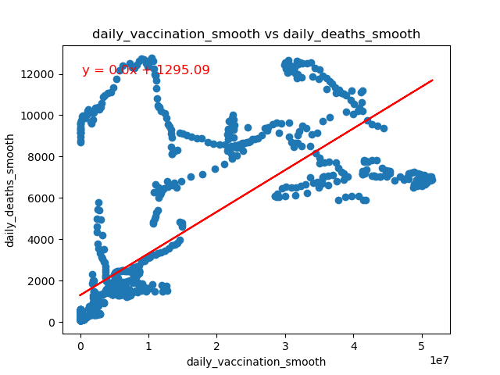
Analysis Is there a Correlation between Covid vaccination compaign and deaths?
When we compare the evolution of the vaccines with the daily deaths number, we observe that there is no correlation ,
The data si skewed and does not follow an obvious pattern

Slide 7
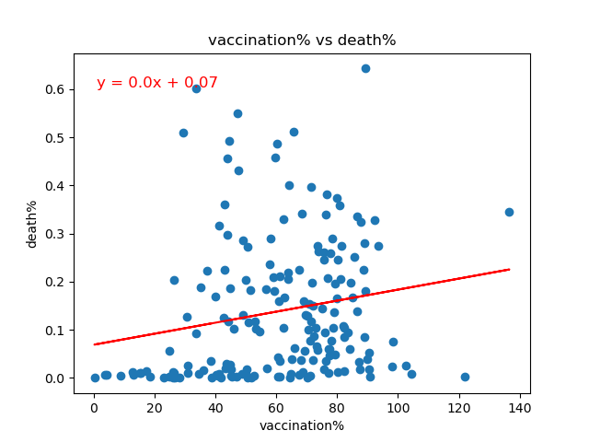
Analysis Is there a Correlation between Covid vaccination compaign and deaths?
This observation is confirmed when we compare the vaccination% (compared to the total population) and the deaths%, country by country
In this case we also does not observe a correlation between the 2 sets of data collected for 200 countries.

Slide 8
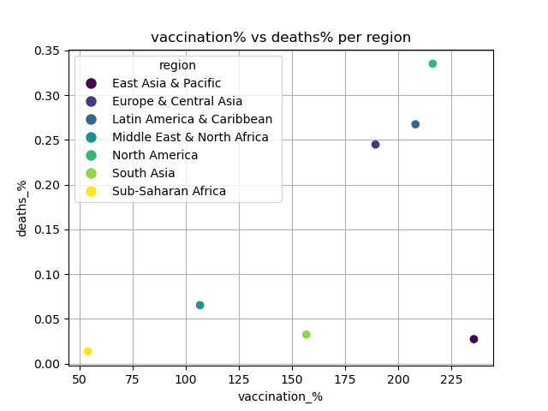
Analysis Is there a Correlation between Covid vaccination compaign and deaths?
If we aggregate the countries by region, this observation is confirmed
- no correlation between both indicators
However, we recognize some specifics that can explain the impact of the pandemic in the world
Sub-Saharan Africa : the impact was limited and observed from the beginning (no explanation till now). The most probable is a natural immunization of the population to the sever consequences.
Asia : the contingent policies that last longer could explain the limitation of deaths in these areas
There are 3 regions highly impacted with sever consequences : ???

